Slide 1
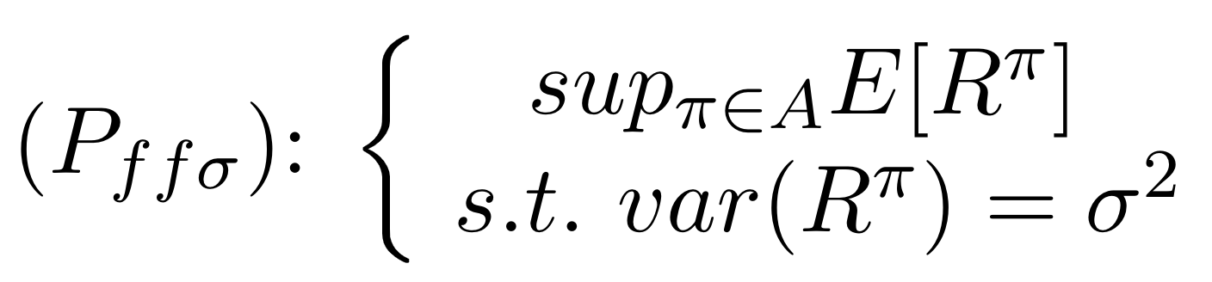
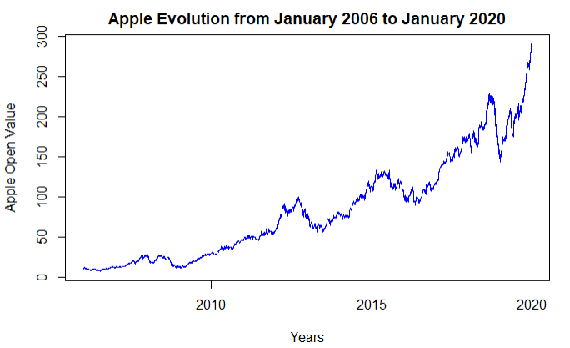

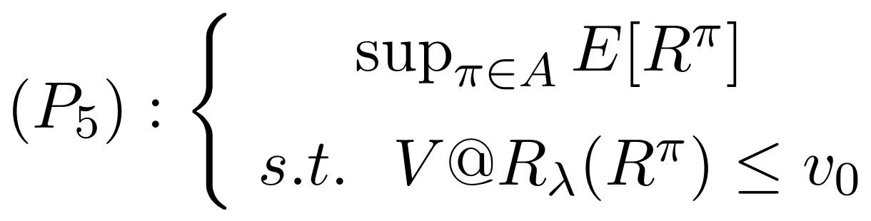
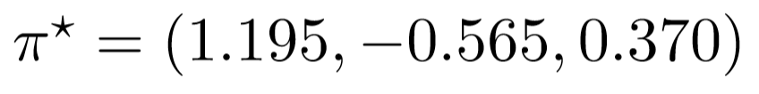
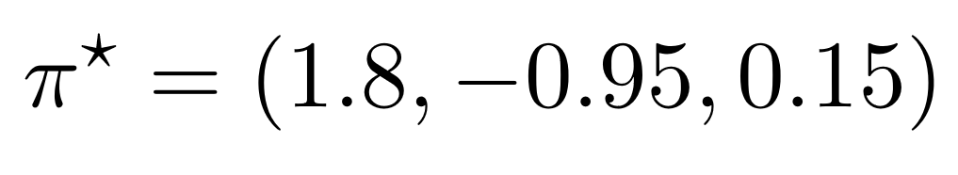
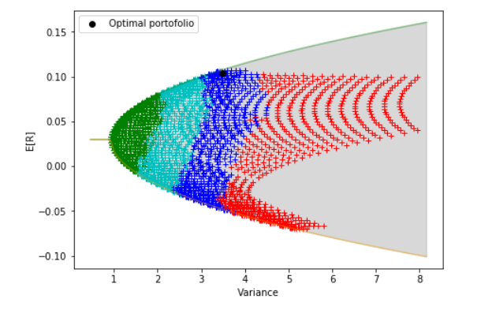
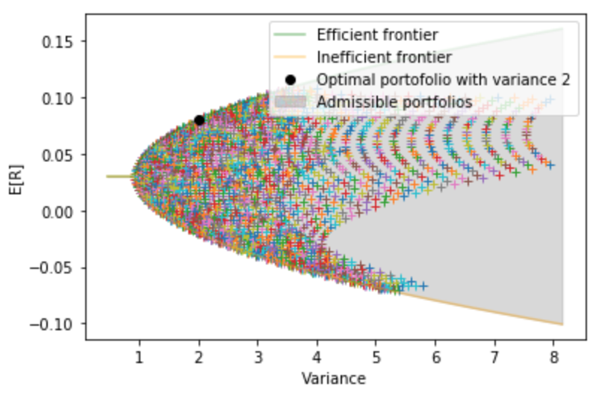
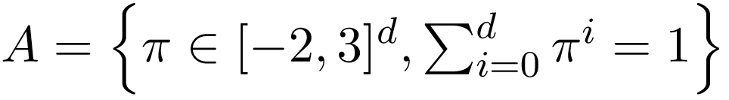

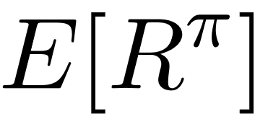
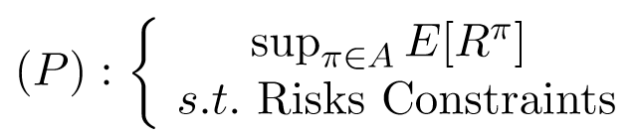
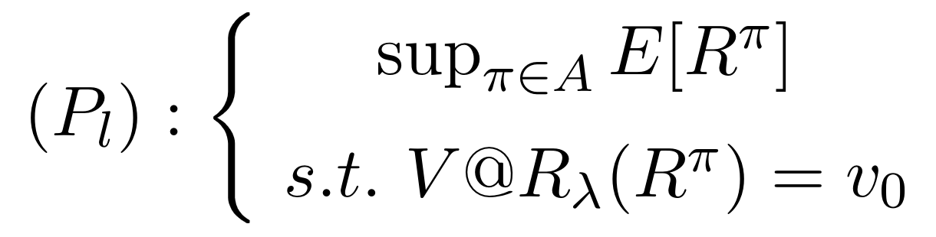
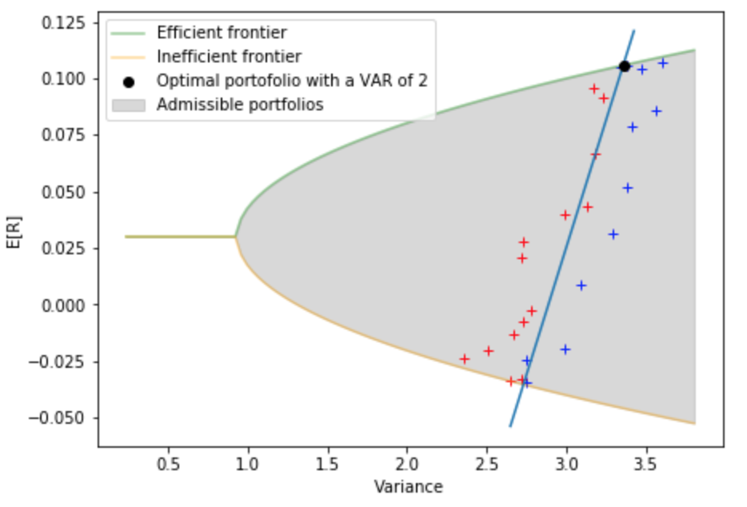
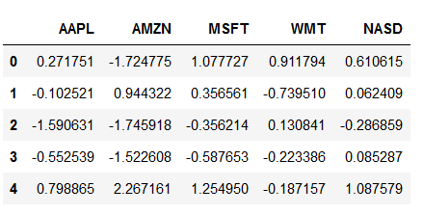
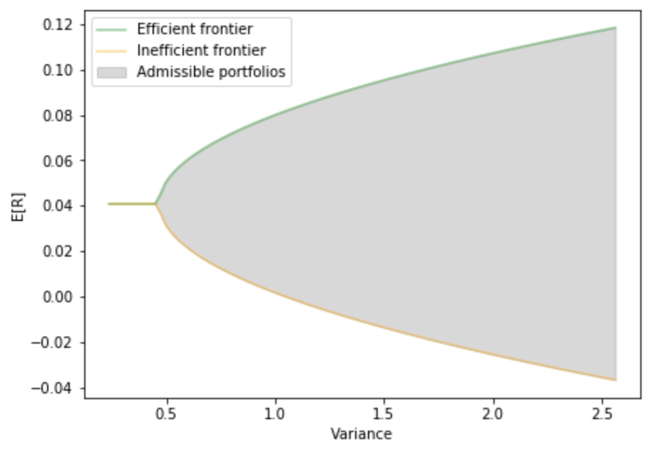
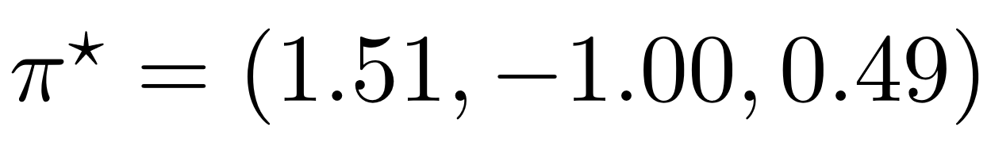
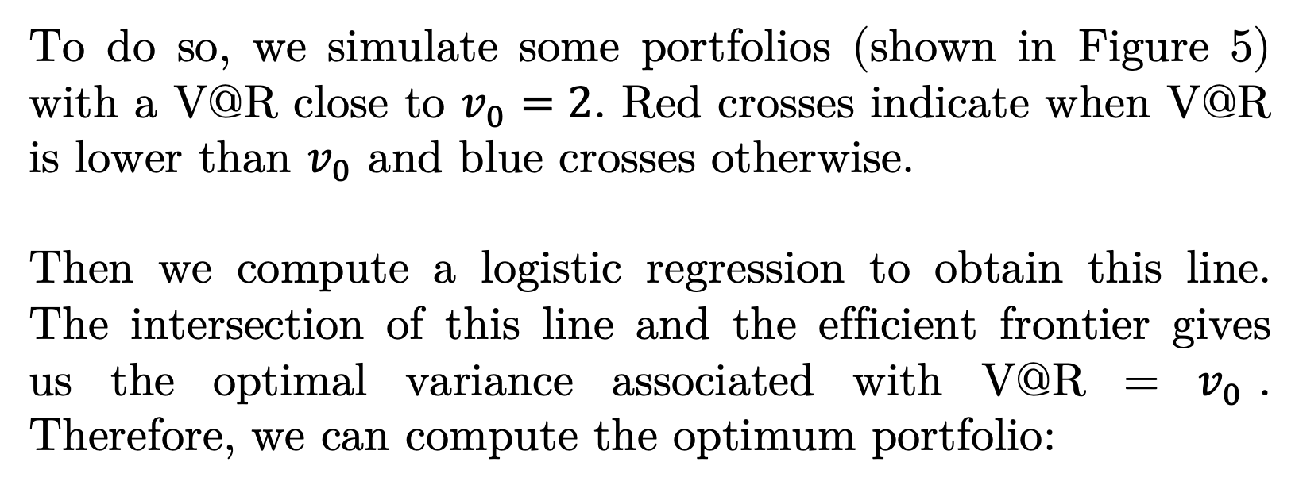
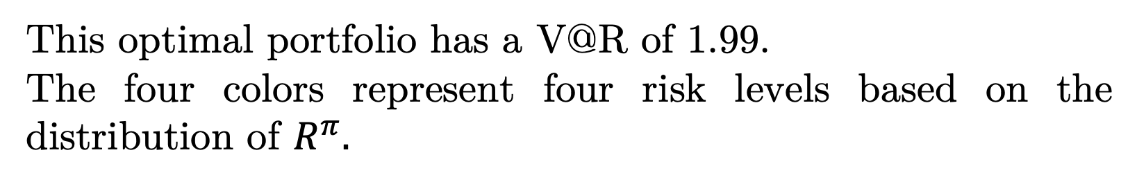
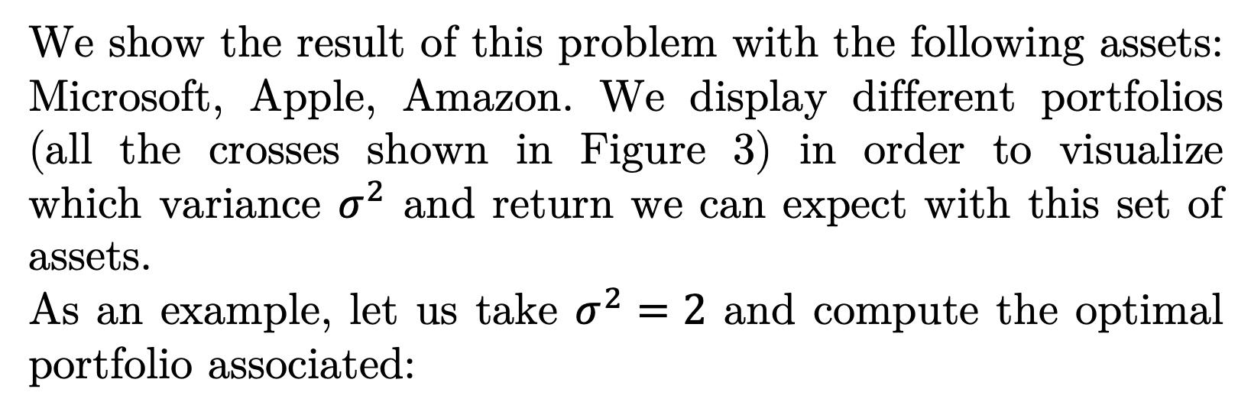
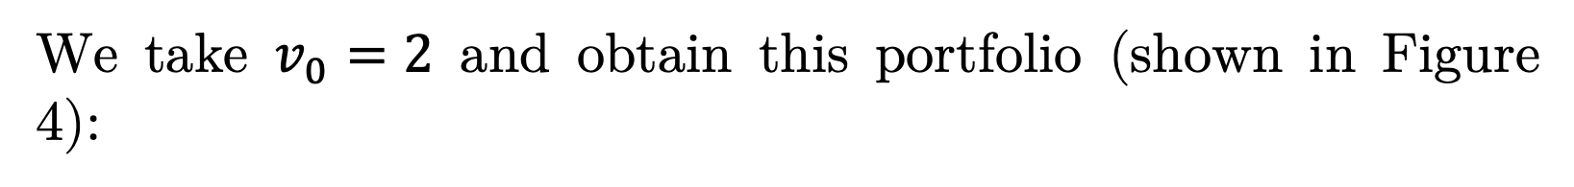
Stock portfolio optimization subject to risk constraints with simple management
Maxime Doré | Jules Nahon
Students at INSA Toulouse
Department of Applied Mathematics
dore@etud.insa-toulouse.fr | nahon@etud.insa-toulouse.fr
Tutor: Anthony Réveillac
Professor at INSA Toulouse
Department of Applied Mathematics
anthony.reveillac@insa-toulouse.fr
Introduction
Best Strategy Considering Variance
Best Strategy Considering Value at Risk
Discussion
A portfolio is a grouping of financial assets, such as stocks, bonds, commodities or currencies. It is composed of an initial capital brought by the individual and the proportions allocated to each assets the individual invests in.
We have seen different portfolio behaviors. In order to increase the expected return of a portfolio, short sales are necessary even if this implies an increasing variance. The efficient frontiers allow us to find an optimum portfolio for any given variance; some of them are not attainable in our simulations as they required too many short sales. The aim was then to find an optimum portfolio for a given risk measure. Implementing a stochastic optimization algorithm enables us to find an optimum portfolio under the V@R constraint.
We finally came up with the idea of finding a numerical link between the variance and the V@R after seeing the results of the graphs. This link enables us to find the optimum portfolio very quickly for a given V@R.
Therefore, we implemented a means of finding the optimum investment strategy for an agent with a passive portfolio management on a given set of assets.
This is an introduction to stock portfolio management with a simple investment strategy, a more sophisticated strategy should be elaborated, including other assets. Then, using temporal series to have an idea of the future behaviour of the stocks and applying the optimisation techniques found in this paper to this data will allow us to find an optimum portfolio.
We find the best strategy by solving:
Value at Risk is a risk measure defined as:
We will only focus on for investing in American Stocks (Amazon, Apple, Microsoft, the Nasdaq Index, Walmart) for the period from 2010 to 2018.
We show the result of this problem with the following assets: Microsoft, Apple, Amazon. We display different portfolios (all the crosses shown in Figure 3) in order to visualize which variance $σ^{2}$ and return we can expect with this set of assets.
As an example, let us take $σ^{2}=2$ and compute the optimal portfolio associated:
We find the best strategy by solving:
We solve this problem using the Metropolis Hasting algorithm
We take $v_{0}=2$ and obtain this portfolio (shown in Figure 4):
Figure 1: Evolution of Apple’s Stock Value
Each component represents the proportion of wealth invested in each asset. We display this portfolio with a black point in Figure 3, it appears on the efficient frontier. Therefore, it is an optimum portfolio.
Basics Notions
Market Model: d risky assets are available. We suppose that there are no transaction or order cost. We allow short sales with a limit of 200% of the initial capital.
Investment Strategy: Invest at time t=0 in risky assets and study their return at time t=8 years. This strategy corresponds to a passive management that an individual would make for a long term investment strategy.
Portfolios Value and Profitability: the set of all admissible portfolio is . The return of a portfolio being stochastic, as it relies on the profitability of the assets, we study the expected return . The investor wants to maximize the profitability of his portfolio while having the smallest risk possible. Therefore, the optimization problem that we solve is:
Figure 4: Optimal portfolio for a given V@R of 2
This optimal portfolio has a V@R of 1.99.
The four colors represent four risk levels based on the distribution of $R^{π}.$
Our goal is to find such a portfolio for our investment strategy.
Figure 3: Optimal portfolio for a given variance of 2
Simulation methods
Best Strategy Considering Variance Linked to a Value at Risk
We download historic data from 2010 to 2018 for each asset, compute the daily returns and export them into a DataFrame:
We now want to solve this problem:
However, even if we find the best strategy and apply it to the predicted data, there is a high probability that the market will not evolve as predicted.
Indeed, the rational or irrational behaviour of the agents on the market cannot always be predicted, nor can sanitary crises like Covid-19 or the financial crisis such as in 2008.
Each column represents an asset and each row a day.
We then generate the admissible portfolios with a discretization step of 0.05. We show that for a given variance, we can find an efficient and inefficient portfolio.
As the borders between risk levels shown in Figure 4 are linear, we want to find the line that correspong to:
To do so, we simulate some portfolios (shown in Figure 5) with a V@R close to $v_{0}=2$. Red crosses indicate when V@R is lower than $v_{0}$ and blue crosses otherwise.
Then we compute a logistic regression to obtain this line. The intersection of this line and the efficient frontier gives us the optimal variance associated with V@R = $v_{0}$. Therefore, we can compute the optimum portfolio:
References
Figure 2 represents the admissible portfolios area with all the five assets. We can see two frontiers called efficient and inefficient frontiers representing the maximum and minimum expected return for a given variance.
Figure 2: Frontiers of the optimization
which has a V@R of 2.03 close to $v_{0}$.
Figure 5: Optimal portfolio for a given V@R of 2

